Slide 1

Computational and Experimental characterization of the catalytic activity of
artificial enzymes based on the LmrR scaffold
Workflow (EVB)
FEP
State of the Art
Results

Slide 2
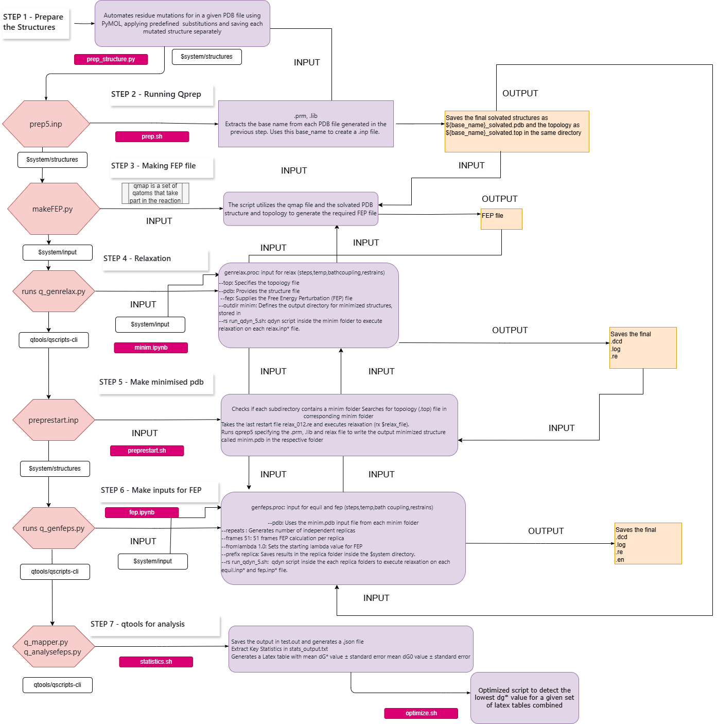
Workflow
Detailed Workflow to run EVB on several mutations
https://github.com/ND7996/GPX6

Slide 3
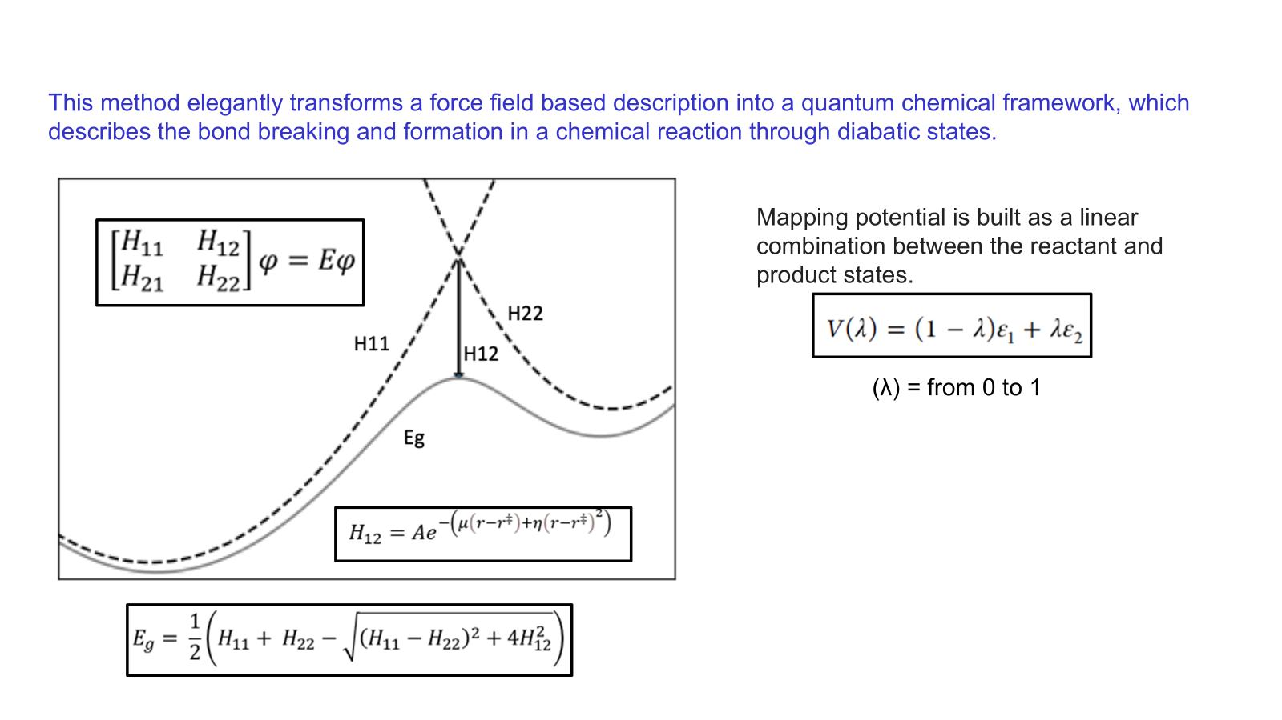
FEP
PREPARE
ANALYSE
SIMULATE
Qprep
Qfep
Qdyn

Slide 4
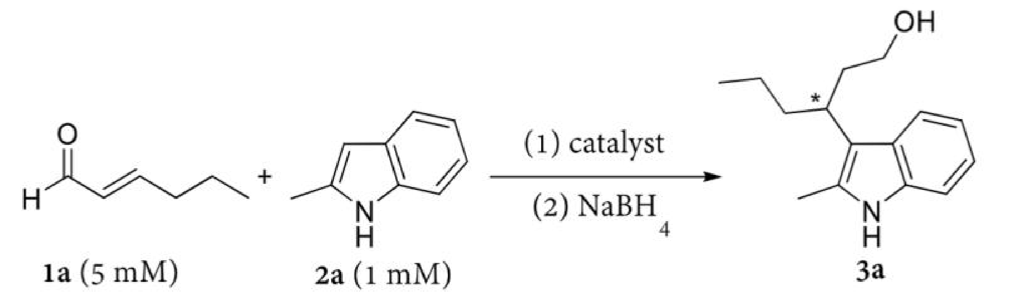
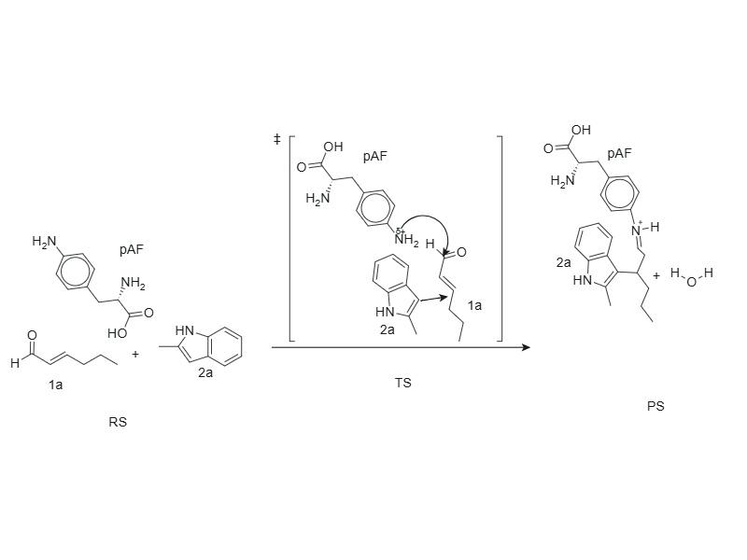
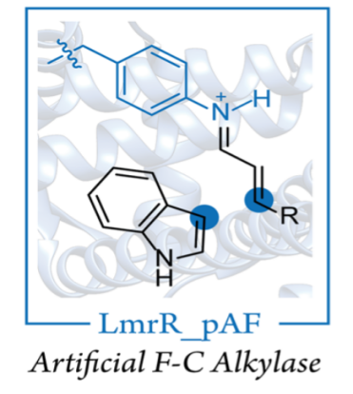
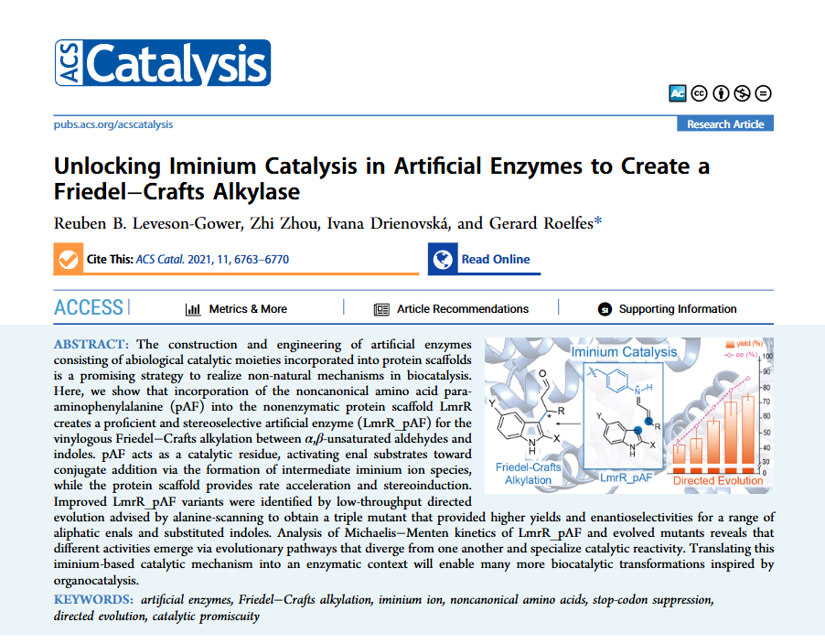
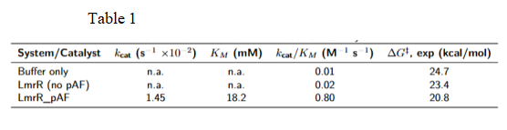
State of the Art
Mechanism

Slide 5
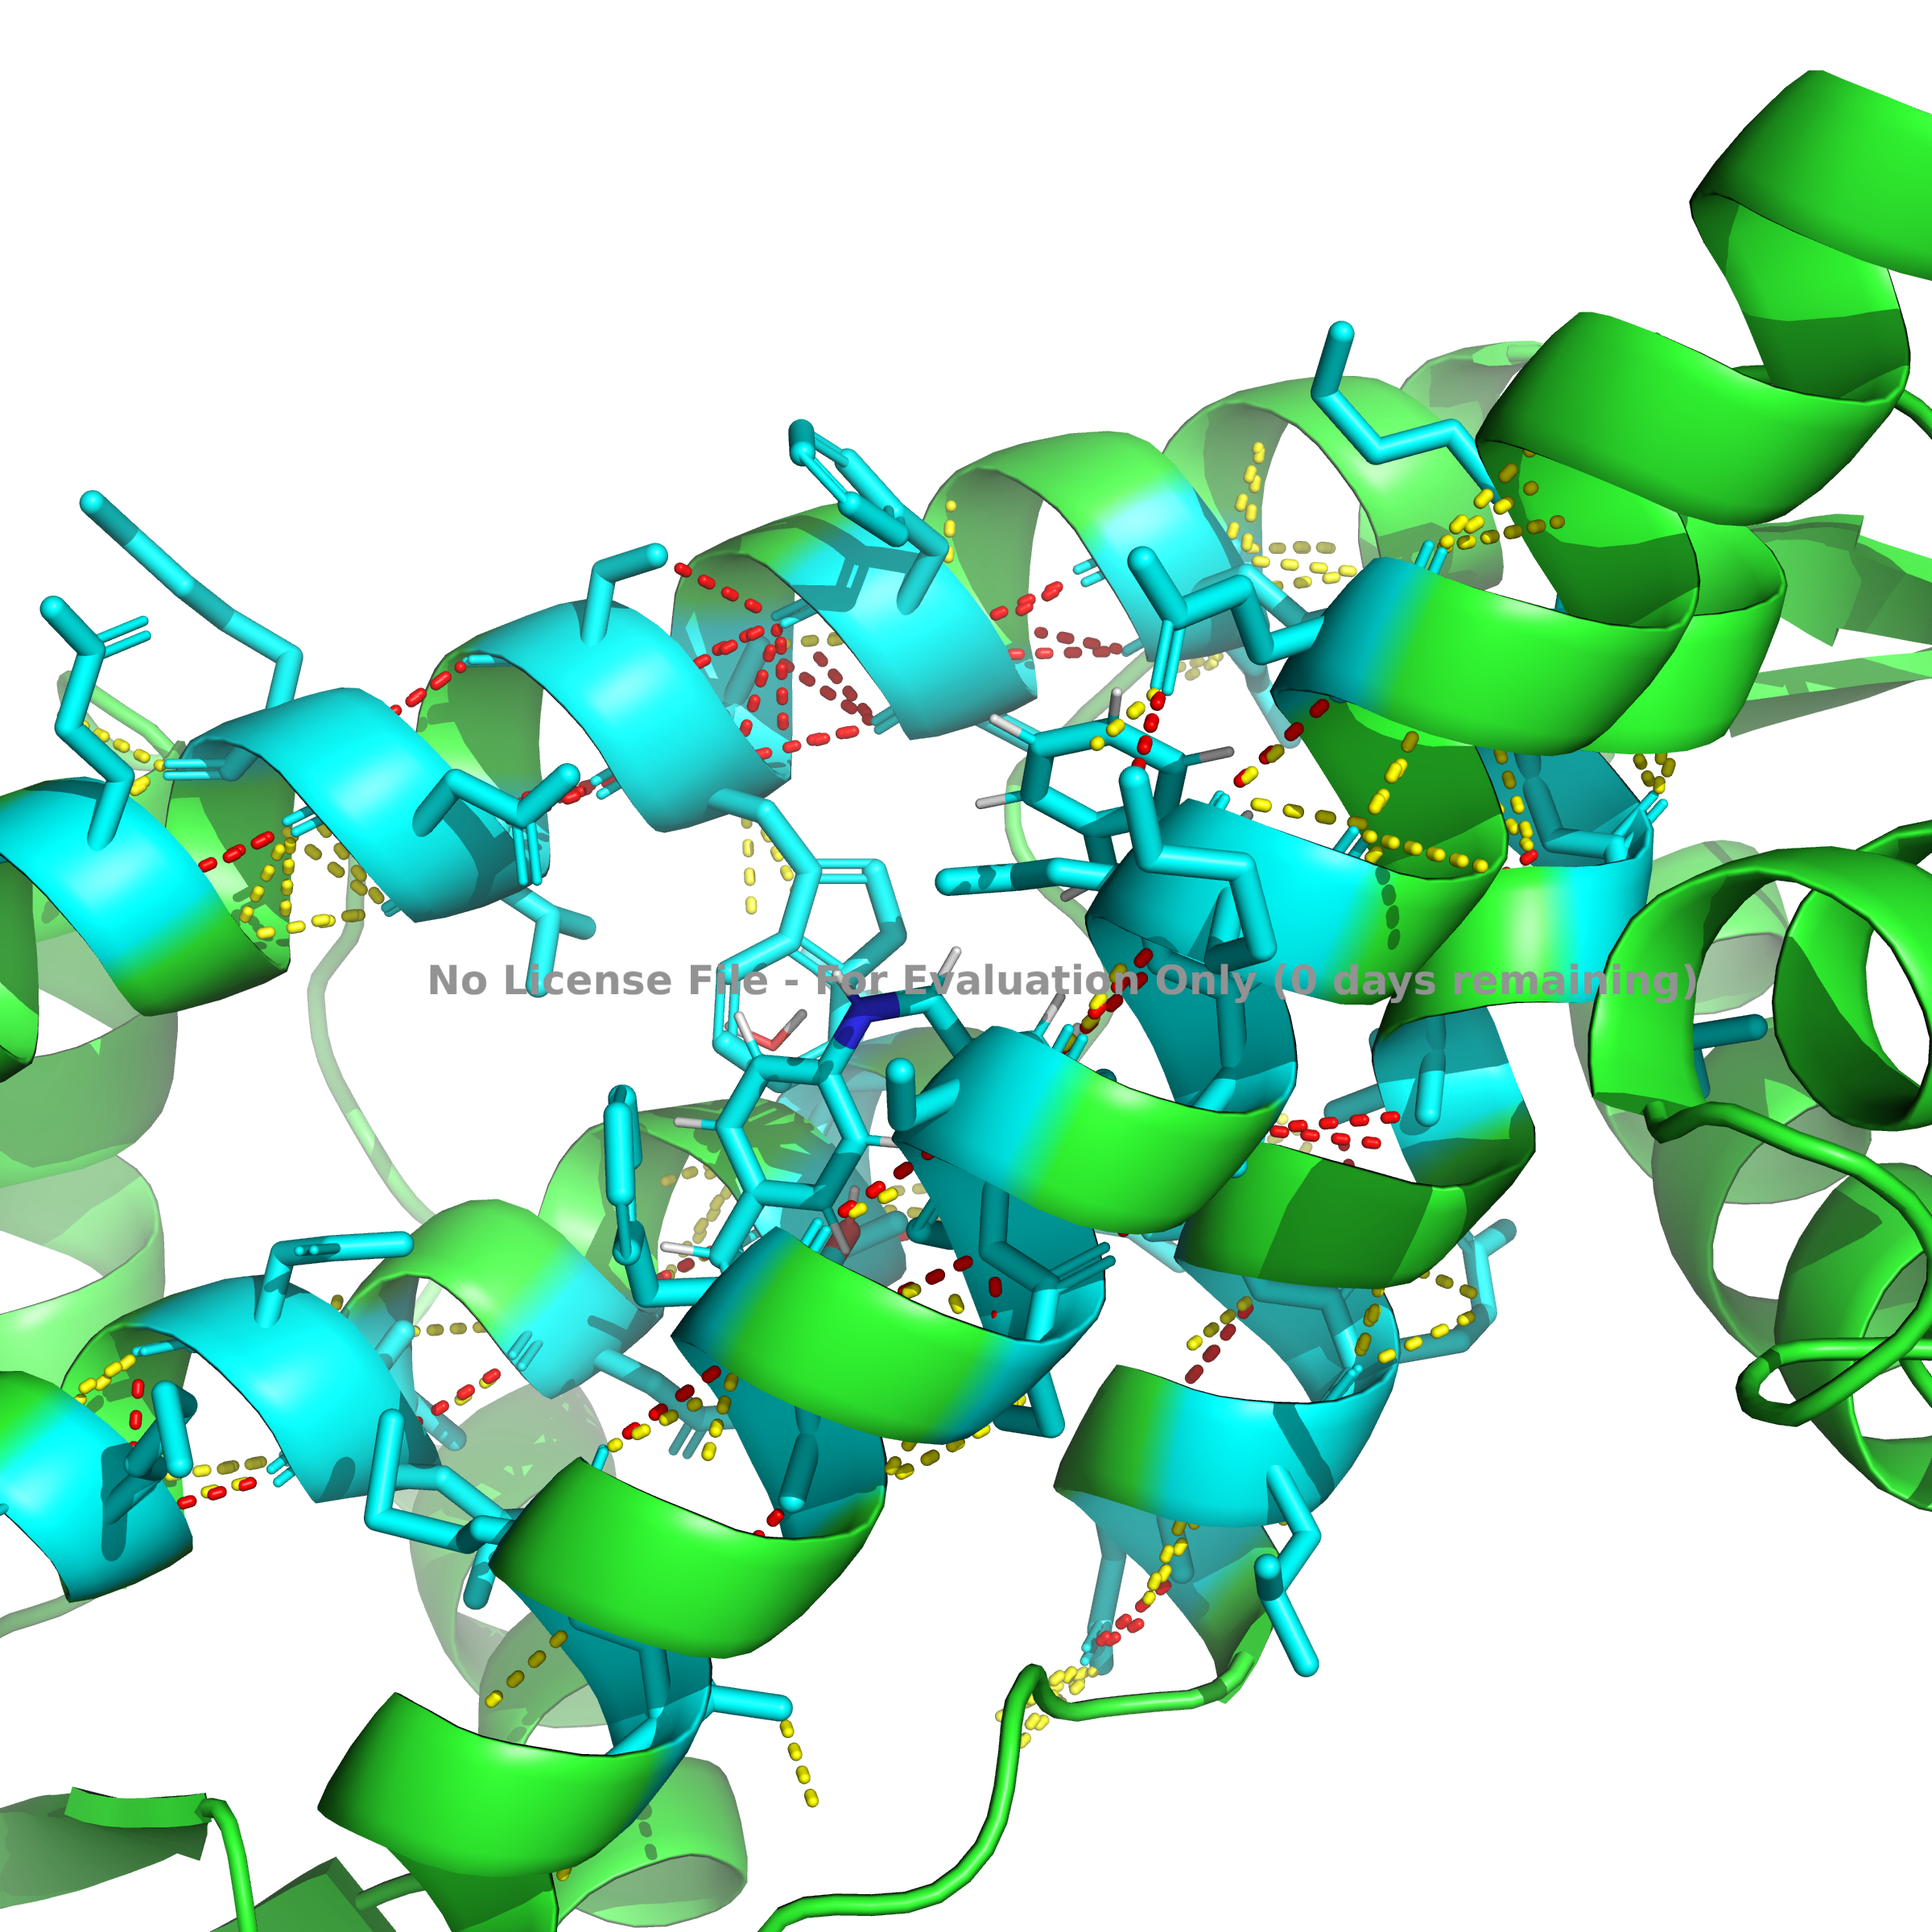
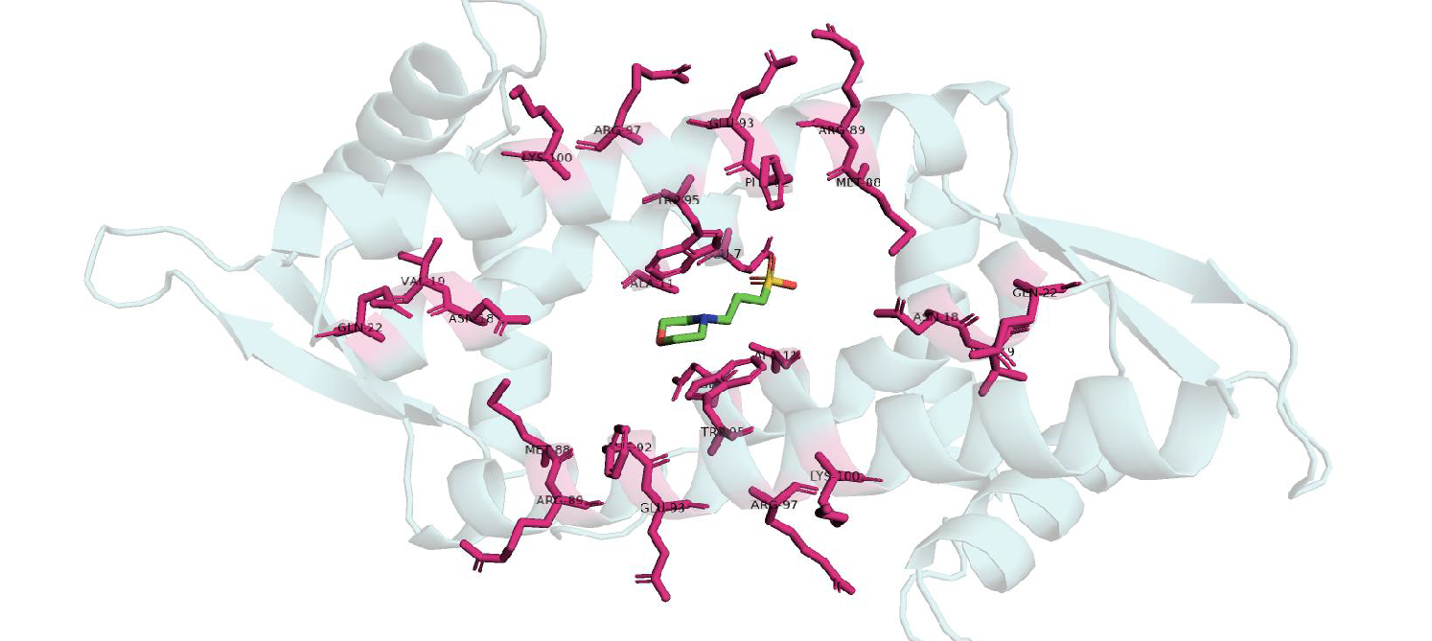
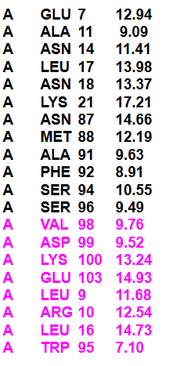
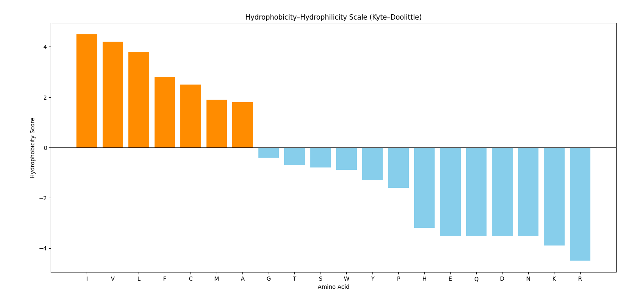
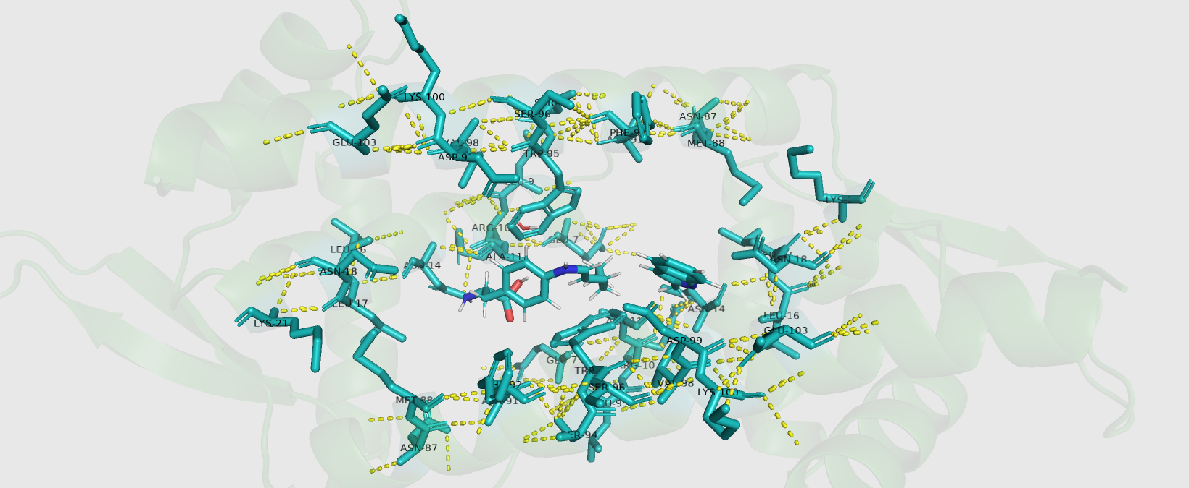
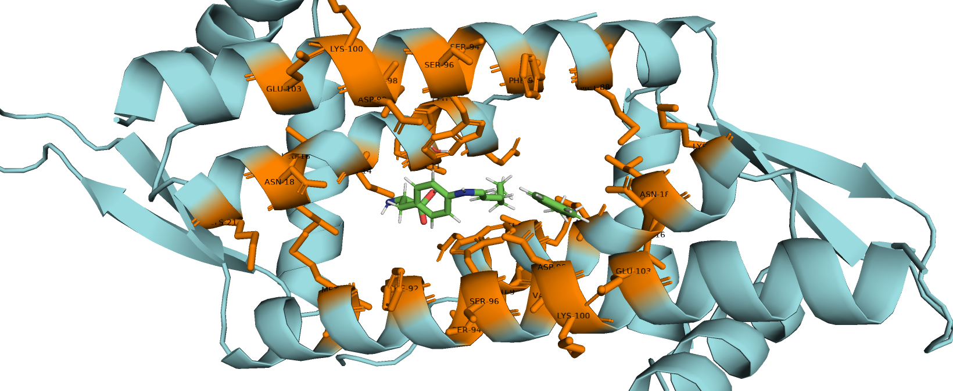
Structural Significance
Previous Mutants
Distances between CA of the mutant to N of PAF (the ones in magenta are new mutants)
Additional Mutants

Slide 6
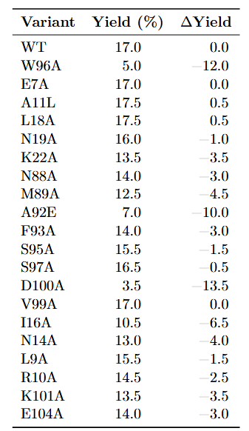
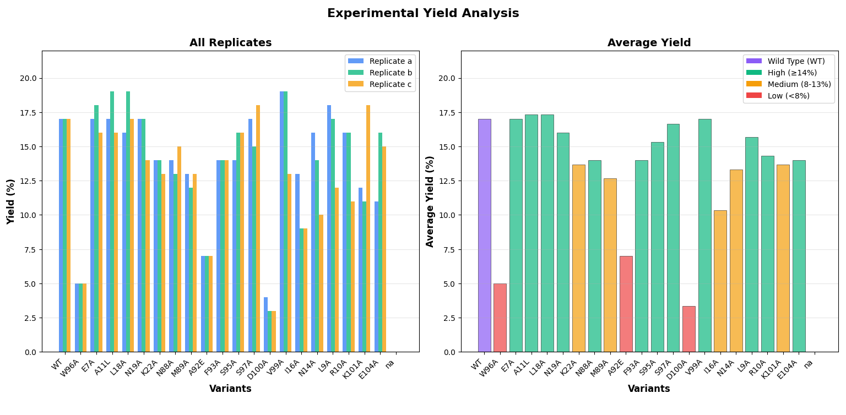
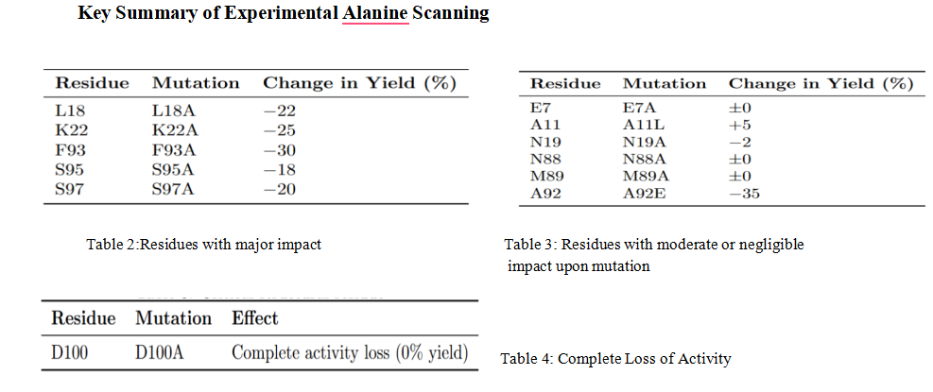
Results
Current Results
Previous Results
Overall Trends: Most mutants retain 70–100% activity (high/medium). Only W96A, A92E, D100A show major losses (<10% yield).

